Slide 1
Chapter 16
Introducing Swing
李晔锋

Slide 2
Key Skills & Concepts
Know the origins and design philosophy of Swing
Understand Swing components and containers
Know layout manager basics
Create, compile, and run a simple Swing application
Learn event handling fundamentals
Use JButton
Work with JTextField
Create a JCheckBox
Work with JList
Use anonymous inner classes or lambda expressions to handle events

Slide 3
Basic Conception of Swing
With very few exceptions, Swing components are lightweight. This means that a component is written entirely in Java. They do not rely on platform-specific peers.

Slide 4
The Conception of MVC
Swing’s pluggable look and feel is made possible because Swing uses a modified version of the classic model-view-controller (MVC) architecture.
The model corresponds to the state information associated with the component. The view determines how the component is displayed on the screen, including any aspects of the view that are affected by the current state of the model. The controller determines how the component reacts to the user.

Slide 5
Components and Containers
A Swing GUI consists of two key items: components and containers. However, this distinction is mostly conceptual because all containers are also components.
The difference between the two is found in their intended purpose: As the term is commonly used, a component is an independent visual control, such as a push button or text field. A container holds a group of components. Thus, a container is a special type of component that is designed to hold other components.

Slide 6
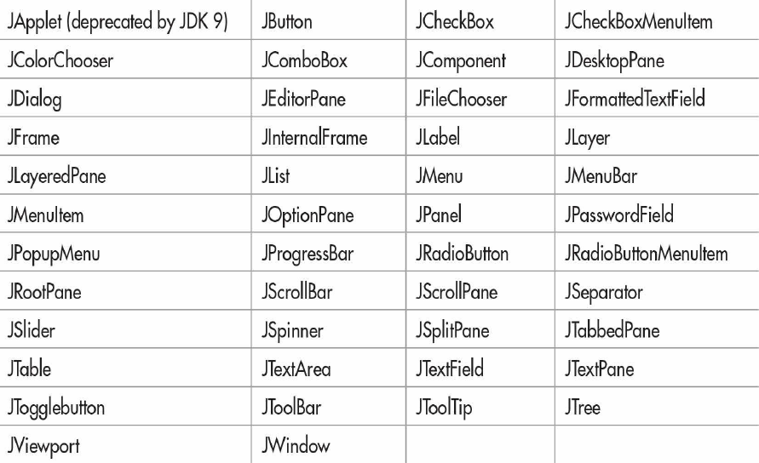
Components
In general, Swing components are derived from the JComponent class. JComponent provides the functionality that is common to all components.

Slide 7
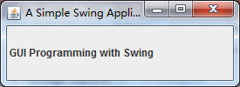
A First Simple Swing Program
public class SwingDemo {
SwingDemo(){
JFrame jfrm = new JFrame("A Simple Swing Application");
jfrm.setSize(275,100);
jfrm.setDefaultCloseOperation(JFrame.EXIT_ON_CLOSE);
JLabel jlab = new JLabel(" GUI Programming with Swing");
jfrm.add(jlab);
jfrm.setVisible(true);
}
public static void main(String[] args) {
// TODO Auto-generated method stub
SwingUtilities.invokeLater(new Runnable() {
public void run() {
new SwingDemo();
}
});
}
}

Slide 8
The JFrame Class
It is easy to create a JFrame window using the default constructor, or with a title name.
public JFrame();
public JFrame(String name);
The JFrame class has some useful methods as follows:
public void setVisible(boolean b): If b is true, then the window is visible. It is invisible by default.
public void dispose(): Cancel current window, and release all the resources.
public void setDefaultCloseOperation(int operation): When you click the cross button, it will close the windows according to your operation.

Slide 9
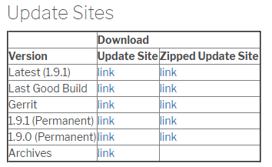
Use the Swing Plugin in Eclipse
The Eclipse official website provides a plugin, WindowBuilder, for Swing designers, which can reduce the code writing work. Its website is as follows:
https://www.eclipse.org/windowbuilder/download.php
You will see a Update Site table below, click the first “link”, and jump to the next page.

Slide 10
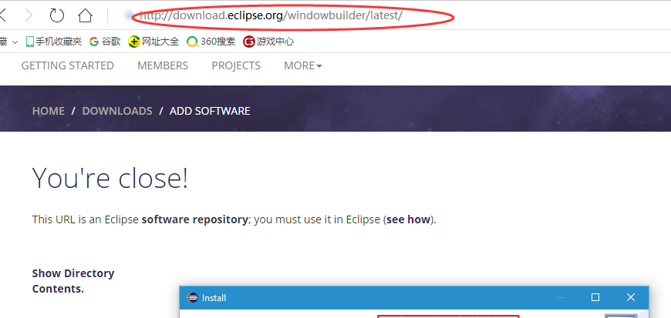
Use the Swing Plugin in Eclipse
Copy the address in the browser.

Slide 11
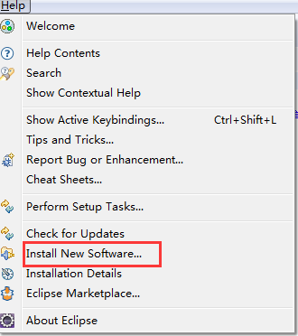
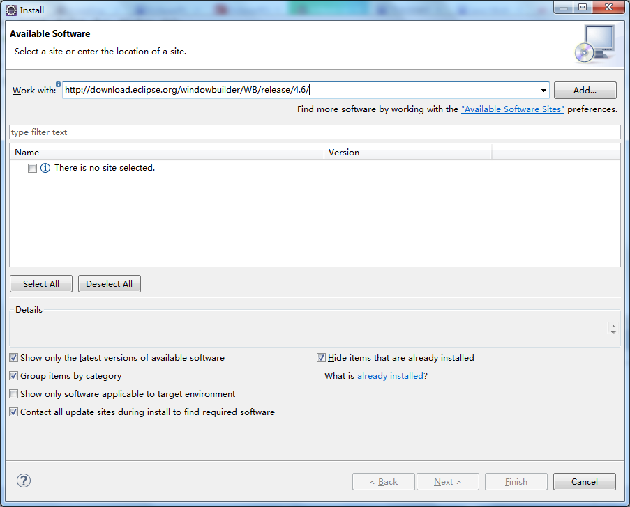
Use the Swing Plugin in Eclipse
From the menu of Eclipse, click “help” → “Install New Software”, then paste the link and click “Add”. A new dialog will pop up and input an arbitrary name, i.e., WindowBuilder.

Slide 12
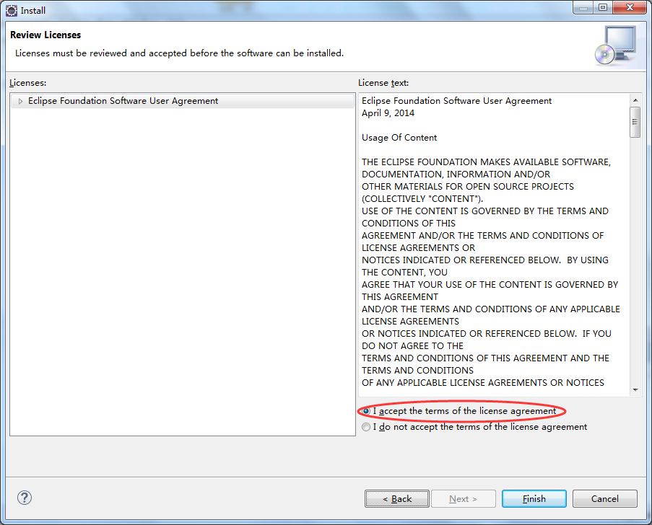
Use the Swing Plugin in Eclipse
Click “Select All” and then “Next” until the license dialog, accept the license, and click “Finish” to start installing.

Slide 13
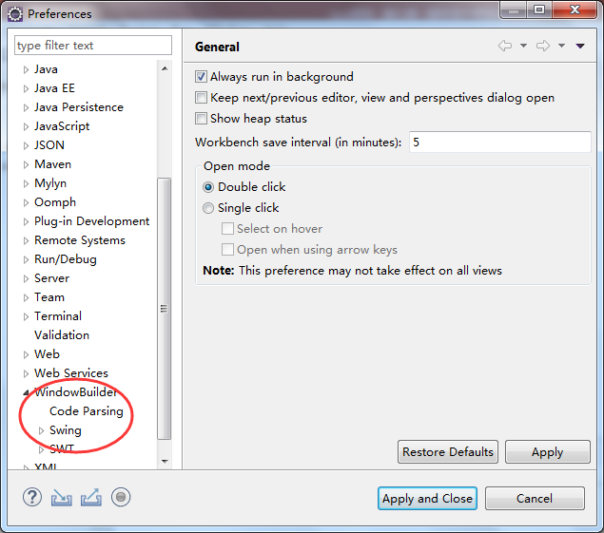
Use the Swing Plugin in Eclipse
When you finish installing, Eclipse will require you to restart. After that, click “Window” → “Preferences” on the menu. If you find “Window Builder” there with no problems, then it is successfully installed.

Slide 14
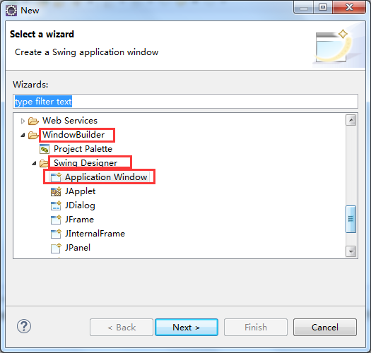
Usage of the WindowBuilder Plugin
Create a Java project, then right click on the src folder, select “new” → “Other”. From the dialog, you will find out “Window Builder”, expand it and then “Swing Designer”. Select the “Application Window” or “JFrame”, click “Next”.

Slide 15
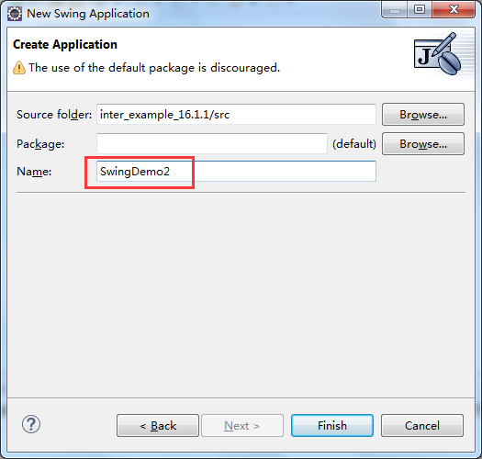
Usage of the WindowBuilder Plugin
OK, now enter the class name, then an initial code is generated. You can make any changes to it.

Slide 16
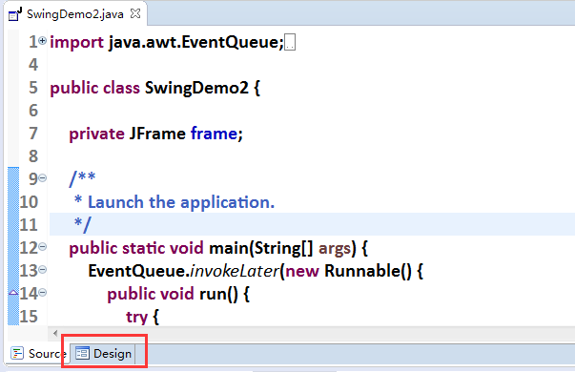
Usage of the WindowBuilder Plugin
Here’s the code, but you will see the “design” panel here…

Slide 17
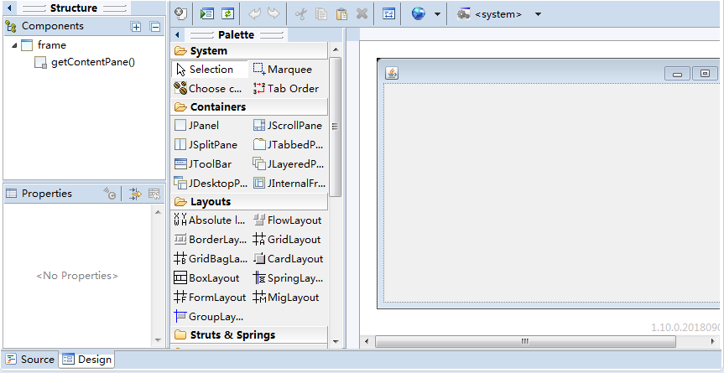
Usage of the WindowBuilder Plugin
After you clicked “design”, you will find it is really powerful…

Slide 18
Containers
Swing defines two types of containers. The first are top-level containers: JFrame, JApplet, JWindow, and JDialog. These containers do not inherit JComponent.
The second type of container supported by Swing is the lightweight container. Lightweight containers do inherit JComponent. Examples of lightweight containers are JPanel, JScrollPane, and JRootPane.

Slide 19
JPanel
JPanel is the most commonly used container. You can directly add it to a frame as follows:
JFrame jfrm = new JFrame();
JPanel jpane = new JPanel();
jfrm.add(jpane);

Slide 20
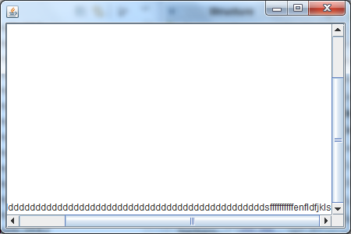
JScrollPane
This pane has scroll bars, it is often used for large-sized TextArea.

Slide 21
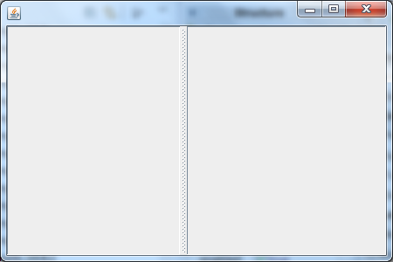
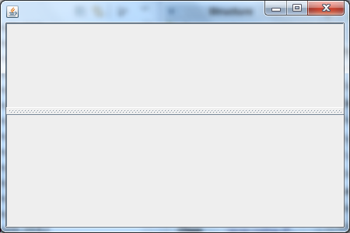
JSplitPane
There are two types of split pane: vertical and horizontal.

Slide 22
The Top-Level Container Panes
Each top-level container defines a set of panes. At the top of the hierarchy is an instance of JRootPane. JRootPane is a lightweight container whose purpose is to manage the other panes. It also helps manage the optional menu bar. The panes that compose the root pane are called the glass pane, the content pane, and the layered pane.

Slide 23
The Glass Pane and The Layered Pane
The glass pane is the top-level pane. It sits above and completely covers all other panes. The glass pane enables you to manage mouse events that affect the entire container (rather than an individual control) or to paint over any other component.
The layered pane allows components to be given a depth value. This value determines which component overlays another. The layered pane holds the content pane and the (optional) menu bar.

Slide 24
The Content Pane
The pane with which your application will interact the most is the content pane, because this is the pane to which you will add visual components. In other words, when you add a component, such as a button, to a top-level container, you will add it to the content pane. Therefore, the content pane holds the components that the user interacts with.

Slide 25
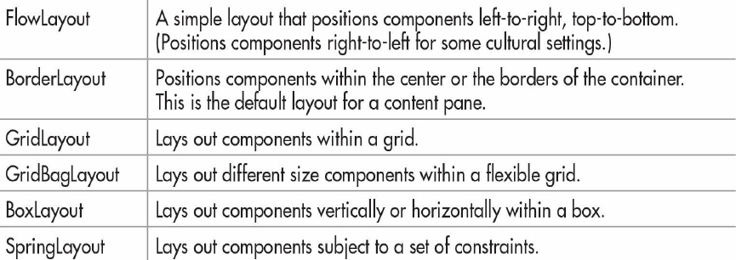
Layout Managers
The layout manager controls the position of components within a container. Here is a list of a few of the layout managers available to the Swing programmer:

Slide 26
FlowLayout
FlowLayout is the most commonly used. It lays out components one row at a time, top to bottom. When one row is full, layout advances to the next row.
FlowLayout flow = new FlowLayout();
con.setLayout(flow);

Slide 27
BorderLayout
BorderLayout is the default layout manager for the content pane. It implements a layout style that defines five locations to which a component can be added. The first is the center. The other four are the sides (i.e., borders), which are called north, south, east, and west. By default, when you add a component to the content pane, you are adding the component to the center. To add a component to one of the other regions, specify its name. For example:
con.add(b1,BorderLayout.CENTER);
con.add(b2,BorderLayout.NORTH);

Slide 28
GridLayout
GridLayout divides the container into m rows and n columns. It is initialized as follows:
GridLayout grid = new GridLayout(10,8);

Slide 29
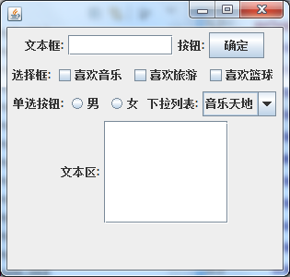
Components in FlowLayout Demo
Attention: If you resize the window, the position of components might be changed.

Slide 30
Swing Event Handling
The event handling mechanism used by Swing is called the delegation event model. Its concept is quite simple. An event source generates an event and sends it to one or more listeners. With this approach, the listener simply waits until it receives an event. Once an event arrives, the listener processes the event and then returns.
The advantage of this design is that the application logic that processes events is cleanly separated from the user interface logic that generates the events.

Slide 31
Events
In Java, an event is an object that describes a state change in an event source. It can be generated as a consequence of a person interacting with an element in a graphical user interface or generated under program control. The superclass for all events is java.util.EventObject.

Slide 32
Event Sources
An event source is an object that generates an event. When a source generates an event, it sends that event to all registered listeners. Therefore, in order for a listener to receive an event, it must register with the source of that event.
In Swing, listeners register with a source by calling a method on the event source object. Each type of event has its own registration method. Typically, events use the following naming convention:
public void addTypeListener(TypeListener el)
Here, Type is the name of the event and el is a reference to the event listener.

Slide 33
Event Sources
A source must also provide a method that allows a listener to unregister an interest in a specific type of event. In Swing, the naming convention of such a method is this:
public void removeTypeListener(TypeListener el)
Again, Type is the name of the event and el is a reference to the event listener.

Slide 34
Event Listeners
A listener is an object that is notified when an event occurs. It has two major requirements. First, it must have registered with one or more sources to receive a specific type of event. Second, it must implement a method to receive and process that event.
The methods that receive and process events applicable to Swing are defined in a set of interfaces. For example, the ActionListener interface defines a method that handles an ActionEvent. Any object may receive and process this event if it provides an implementation of the ActionListener interface.

Slide 35
Event Classes and Listener Interfaces
The classes that represent events are at the core of Swing’s event handling mechanism. They are in javax.swing.event. Thus, Swing supports a large number of events.

Slide 36
Use JButton
A push button isan instance of JButton. It supplies several constructors. The one used here is:
JButton(String msg)
Here, msg specifies the string that will be displayed inside the button.

Slide 37
Use JButton
When a push button is pressed, it generates an ActionEvent. JButton provides the following methods, which are used to add or remove an action listener:
void addActionListener(ActionListener al)
void removeActionListener(ActionListener al)
Here, al specifies an object that will receive event notifications. This object must be an instance of a class that implements the ActionListener interface.

Slide 38
The ActionListener Interface
The ActionListener interface defines only one method: actionPerformed( ). It is shown here:
void actionPerformed(ActionEvent ae)
This method is called when a button is pressed. In other words, it is the event handler that is called when a button press event has occurred. Your implementation of actionPerformed( ) must quickly respond to that event and return.

Slide 39
JButton Demo
public class ButtonDemo implements ActionListener {
JLabel jlab;
ButtonDemo(){
JFrame jfrm = new JFrame("A Button Example");
jfrm.setLayout(new FlowLayout());
jfrm.setSize(220, 180);
jfrm.setDefaultCloseOperation(JFrame.EXIT_ON_CLOSE);
JButton jbtnUp = new JButton("Up");
JButton jbtnDown = new JButton("Down");
jbtnUp.addActionListener(this);
jbtnDown.addActionListener(this);
jfrm.add(jbtnUp);
jfrm.add(jbtnDown);
jlab = new JLabel("Press a button.");
jfrm.add(jlab);
jfrm.setVisible(true);
}

Slide 40
JButton Demo
@Override
public void actionPerformed(ActionEvent arg0) {
// TODO Auto-generated method stub
if(arg0.getActionCommand().equals("Up"))
jlab.setText("You pressed Up.");
else
jlab.setText("You pressed Down.");
}
public static void main(String[] args) {
// TODO Auto-generated method stub
SwingUtilities.invokeLater(new Runnable() {
public void run() {
new ButtonDemo();
}
});
}
}

Slide 41
The getActionCommand() Method
The parameter passed to the actionPerformed method is an object of ActionEvent. It has a method called getActionCommand(). The usage is as follows:
String getActionCommand( )
The action command identifies the button. Thus, when using two or more buttons within the same application, the action command gives you an easy way to determine which button was pressed.

Slide 42
Action Summary
Event Source
addXXXListerner()
Component
XXXListener
Event
@Override
public void XXXXXX(){
…
}

Slide 43
Work with JTextField
JTextField defines several constructors. The one we will use is shown here:
JTextField(int cols)
Here, cols specifies the width of the text field in columns. It is important to understand that you can enter a string that is longer than the number of columns. It’s just that the physical size of the text field on the screen will be cols columns wide.

Slide 44
Work with JTextField
When you press ENTER when inputting into a text field, an ActionEvent is generated. Therefore, JTextField provides the addActionListener( ) and removeActionListener( ) methods. To handle action events, you must implement the actionPerformed( ) method defined by the ActionListener interface.
AJTextField has an action command string associated with it. You will usually set the action command to a fixed value of your own choosing by calling the setActionCommand( ) method, shown here:
void setActionCommand(String cmd)

Slide 45
Work with JTextField
To obtain the string that is currently displayed in the text field, call getText( ) on the JTextField instance. It is declared as shown here:
String getText( )
You can set the text in a JTextField by calling setText( ), shown next:
void setText(String text)
Here, text is the string that will be put into the text field.

Slide 46
public class TFDemo implements ActionListener {
JTextField jtf;
JButton jbtnRev;
JLabel jlabPrompt,jlabContents;
TFDemo(){
JFrame jfrm = new JFrame("Use a Text Field");
jfrm.setLayout(new FlowLayout());
jfrm.setBounds(100,100,240,120);
jfrm.setDefaultCloseOperation(JFrame.EXIT_ON_CLOSE);
jtf = new JTextField(10);
JButton jbtnRev = new JButton("Reverse");
jtf.addActionListener(this);
jbtnRev.addActionListener(this);
jlabPrompt = new JLabel("Enter text:");
jlabContents = new JLabel("");
jfrm.add(jlabPrompt);
jfrm.add(jtf);
jfrm.add(jbtnRev);
jfrm.add(jlabContents);
jfrm.setVisible(true);
}

Slide 47
@Override
public void actionPerformed(ActionEvent arg0) {
// TODO Auto-generated method stub
if(arg0.getActionCommand().equals("Reverse")) {
String orgStr = jtf.getText();
String resStr = "";
for(int i=orgStr.length()-1;i>=0;i--)
resStr += orgStr.charAt(i);
jtf.setText(resStr);
}else
jlabContents.setText("You pressed ENTER. Text is: "
+ jtf.getText());
}
public static void main(String[] args) {
// TODO Auto-generated method stub
SwingUtilities.invokeLater(new Runnable() {
public void run() {
new TFDemo();
}
});
}
}

Slide 48
Create a JCheckBox
JCheckBox defines several constructors. The one used here is:
JCheckBox(String str)
It creates a check box that has the text specified by str as a label.

Slide 49
Handle the ItemListener
When a check box is selected or deselected (that is, checked or unchecked), an item event is generated. Item events are represented by the ItemEvent class. Item events are handled by classes that implement the ItemListener interface. This interface specifies only one method, itemStateChanged( ), which is shown here:
void itemStateChanged(ItemEvent ie)
The item event is received in ie.

Slide 50
Handle the ItemEvent Object
To obtain a reference to the item that changed, call getItem( ) on the ItemEvent object. This method is shown here:
Object getItem( )
The reference returned must be cast to the component class being handled, which in this case is JCheckBox.

Slide 51
Handle the Text Associated with the Checkbox
You can obtain the text associated with a check box by calling getText( ). You can set the text after a check box is created by calling setText( ).
The easiest way to determine the state of a check box is to call the isSelected( ) method. It is shown here:
boolean isSelected( )
It returns true if the check box is selected and false otherwise.

Slide 52
public class CBDemo implements ItemListener {
JLabel jlabSelected;
JLabel jlabChanged;
JCheckBox jcbAlpha;
JCheckBox jcbBeta;
JCheckBox jcbGamma;
CBDemo(){
JFrame jfrm = new JFrame("Demonstrate Check Boxes");
jfrm.setLayout(new FlowLayout());
jfrm.setBounds(100,100,280,120);
jfrm.setDefaultCloseOperation(JFrame.EXIT_ON_CLOSE);
jlabSelected = new JLabel("");
jlabChanged = new JLabel("");
jcbAlpha = new JCheckBox("Alpha");
jcbBeta = new JCheckBox("Beta");
jcbGamma = new JCheckBox("Gamma");
jcbAlpha.addItemListener(this);
jcbBeta.addItemListener(this);
jcbGamma.addItemListener(this);
jfrm.add(jcbAlpha);
jfrm.add(jcbBeta);
jfrm.add(jcbGamma);
jfrm.add(jlabChanged);
jfrm.add(jlabSelected);
jfrm.setVisible(true);
}

Slide 53
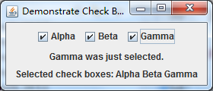
@Override
public void itemStateChanged(ItemEvent arg0) {
// TODO Auto-generated method stub
String str = "";
JCheckBox cb = (JCheckBox)arg0.getItem();
if(cb.isSelected())
jlabChanged.setText(cb.getText() + " was just selected.");
else
jlabChanged.setText(cb.getText() + " was just cleared.");
if(jcbAlpha.isSelected()) str += "Alpha ";
if(jcbBeta.isSelected()) str += "Beta ";
if(jcbGamma.isSelected()) str += "Gamma";
jlabSelected.setText("Selected check boxes: " + str);
}
public static void main(String[] args) {
// TODO Auto-generated method stub
SwingUtilities.invokeLater(new Runnable() {
public void run() {
new CBDemo();
}
});
}
}

Slide 54
Work with JList
Beginning with JDK 7, JList was made generic, and it is now declared like this:
class JList<E>
Here, E represents the type of the items in the list.
JList provides several constructors. The one used here is
JList(E[ ] items)
This creates a JList that contains the items in the array specified by items.

Slide 55
Work with JList
Although a JList will work properly by itself, most of the time you will wrap a JList inside a JScrollPane, which is a container that automatically provides scrolling for its contents. Here is the constructor that we will use:
JScrollPane(Component comp)
Here, comp specifies the component to be scrolled, which in this case will be a JList. When you wrap a JList in a JScrollPane, long lists will automatically be scrollable.

Slide 56
Work with JList
A JList generates a ListSelectionEvent when the user makes or changes a selection. This event is also generated when the user deselects an item. It is handled by implementing ListSelectionListener, which is packaged in javax.swing.event. This listener specifies only one method, called valueChanged( ), which is shown here:
void valueChanged(ListSelectionEvent le)
Here, le is a reference to the object that generated the event.

Slide 57
Work with JList
By default, a JList allows the user to select multiple ranges of items within the list, but you can change this behavior by calling setSelectionMode( ), which is defined by JList. It is shown here:
void setSelectionMode(int mode)
Here, mode specifies the selection mode. It must be one of these values defined by the ListSelectionModel interface:
SINGLE_SELECTION
SINGLE_INTERVAL_SELECTION
MULTIPLE_INTERVAL_SELECTION

Slide 58
Work with JList
You can obtain the index of the first item selected, which will also be the index of the only selected item when using single-selection mode, by calling getSelectedIndex( ), shown here:
int getSelectedIndex( )
Indexing begins at zero. So, if the first item is selected, this method will return 0. If no item is selected, –1 is returned.
You can obtain an array containing all selected items by calling getSelectedIndices( ), shown next:
int[ ] getSelectedIndices( )
In the returned array, the indices are ordered from smallest to largest. If a zero-length array is returned, it means that no items are selected.

Slide 59
public class ListDemo implements ListSelectionListener {
JList<String> jlst;
JLabel jlab;
JScrollPane jscrlp;
String names[] = {"Sherry","Jon","Ranchel",
"Sasha","Josselyn","Randy",
"Tom","Mary","Ken",
"Andrew","Matt","Todd"};
ListDemo(){
JFrame jfrm = new JFrame("JList Demo");
jfrm.setLayout(new FlowLayout());
jfrm.setBounds(100,100,200,160);
jfrm.setDefaultCloseOperation(JFrame.EXIT_ON_CLOSE);
jlst = new JList<String>(names);
jlst.setSelectionMode(ListSelectionModel.SINGLE_SELECTION);
jscrlp = new JScrollPane(jlst);
jscrlp.setPreferredSize(new Dimension(120,90));
jlab = new JLabel("Please choose a name");
jlst.addListSelectionListener(this);
jfrm.add(jscrlp);
jfrm.add(jlab);
jfrm.setVisible(true);
}

Slide 60
@Override
public void valueChanged(ListSelectionEvent arg0) {
// TODO Auto-generated method stub
int idx = jlst.getSelectedIndex();
if(idx != -1)
jlab.setText("Current selection: " + names[idx]);
else
jlab.setText("Please choose a name");
}
public static void main(String[] args) {
// TODO Auto-generated method stub
SwingUtilities.invokeLater(()->new ListDemo());
}
}

Slide 61
Use Anonymous Inner Classes or Lambda Expressions to Handle Events
…

Slide 62
MouseEvent
Mouse event can be handled by any component. The MouseEvent class has the following methods:
getX(): Return the x-axis of the component coordinate.
getY(): Return the y-axis of the component coordinate.
getModifiers(): Get the left button or right button of the mouse.
getClickCount(): Get the click count.
getSource(): Get the event source.
You can add a MouseListener to a component with the addMouseListener method.
addMouseListener(MouseListener ml)

Slide 63
The MouseListener Interface
Attention, the MouseListener is not a functional interface, it contains several methods to be overridden:
MousePressed(MouseEvent me)
MouseReleased(MouseEvent me)
MouseEntered(MouseEvent me)
MouseExited(MouseEvent me)
MouseClicked(MouseEvent me)

Slide 64
public class MouseDemo implements MouseListener {
JTextField text;
JButton button;
JTextArea area;
MouseDemo(){
JFrame frame = new JFrame("Mouse Demo");
frame.setBounds(100,100,450,520);
frame.setDefaultCloseOperation(JFrame.EXIT_ON_CLOSE);
frame.setLayout(new FlowLayout());
text=new JTextField(8);
area=new JTextArea(15,38);
button=new JButton("click me");
text.addMouseListener(this);
button.addMouseListener(this);
frame.addMouseListener(this);
frame.add(button);
frame.add(text);
frame.add(new JScrollPane(area));
frame.setVisible(true);
}

Slide 65
@Override
public void mouseExited(MouseEvent arg0) {
// TODO Auto-generated method stub
area.append("\nMouse exited at:"+"("+arg0.getX()+","+arg0.getY()+")");
}
@Override
public void mousePressed(MouseEvent arg0) {
// TODO Auto-generated method stub
area.append("\nMouse pressed at:"+"("+arg0.getX()+","+arg0.getY()+")");
}
@Override
public void mouseReleased(MouseEvent arg0) {
// TODO Auto-generated method stub
area.append("\nMouse released at:"+ "("+arg0.getX()+","+arg0.getY()+")");
}

Slide 66
public void mouseClicked(MouseEvent arg0) {
// TODO Auto-generated method stub
if(arg0.getClickCount()>=2)
area.append("\nMouse double clicked at:"+"("+arg0.getX()+","+arg0.getY()+")");
}
@Override
public void mouseEntered(MouseEvent arg0) {
// TODO Auto-generated method stub
if(arg0.getSource() instanceof JButton)
area.append("\nMouse entered the button at:" +"("+arg0.getX()+","+arg0.getY()+")");
if(arg0.getSource() instanceof JTextField)
area.append("\nMouse entered the textfield at:"+"("+arg0.getX()+","+arg0.getY()+")");
if(arg0.getSource() instanceof JFrame)
area.append("\nMouse entered the button at:" +"("+arg0.getX()+","+arg0.getY()+")");
}

Slide 67
KeyEvent
Each component can use addKeyListener method to receive KeyEvent.
public void addKeyListener(KeyListener kl)
The KeyListener interface contains the following methods:
public void keyPressed(KeyEvent ke)
public void keyTyped(KeyEvent ke)
public void keyReleased(KeyEvent ke)
The KeyEvent class has the following methods:
public int getKeyCode(): Return the key code that is pressed, released or typed.
public char getKeyChar(): Return the character on the keyboard that is pressed, released or typed.

Slide 68
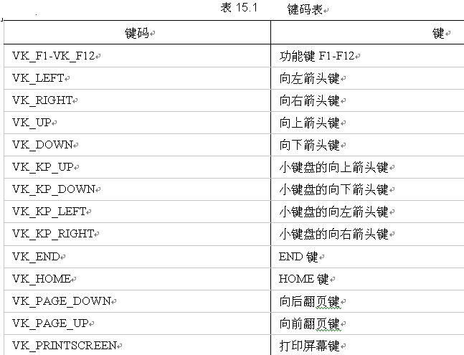

Slide 69
public class KeyDemo implements KeyListener {
JButton jbtn;
KeyDemo(){
JFrame jfrm = new JFrame("Key Press Demo");
jfrm.setBounds(100,100,400,400);
jfrm.setDefaultCloseOperation(JFrame.EXIT_ON_CLOSE);
jfrm.setLayout(null);
jbtn = new JButton("Move");
jbtn.setBounds(150,150,100,60);
jbtn.addKeyListener(this);
jfrm.add(jbtn);
jfrm.setVisible(true);
}

Slide 70
@Override
public void keyPressed(KeyEvent arg0) {
// TODO Auto-generated method stub
int code = arg0.getKeyCode();
int x = jbtn.getBounds().x;
int y = jbtn.getBounds().y;
switch(code) {
case KeyEvent.VK_LEFT: x--;break;
case KeyEvent.VK_RIGHT:x++;break;
case KeyEvent.VK_UP:y--;break;
case KeyEvent.VK_DOWN:y++;break;
}
jbtn.setLocation(x,y);
}
@Override
public void keyReleased(KeyEvent arg0) {
// TODO Auto-generated method stub
}
@Override
public void keyTyped(KeyEvent arg0) {
// TODO Auto-generated method stub
}

Slide 71
Get/Set the Location of a Component
You can get the current location of x-axis and y-axis with its getBounds method:
int x = comp,getBounds().x;
int y = comp.getBounds().y;
If current layout is set to null, or the component is a JLayeredPane object, you can set its location using:
comp.setLocation(a,b);
Where (a,b) is the new axis of the component.

Slide 72
Dialogs
Dialog is one of the top-level containers. All dialogs are subclasses of JDialog. There are two types of dialog.
Modal dialog: If the dialog is activated, other windows in the application will be inactivated.
Modeless dialog: You can active any other windows no matter the dialog is activated.

Slide 73
Dialogs Supported by JOptionPane
The JOptionPane class supports three kinds of dialogs: Message Dialog, Confirm Dialog and Input Dialog. They can be created via the static methods of JOptionPane:
public void showMessageDialog(Component parentComponent, String message, String title, int messageType)
public int showConfirmDialog(Component parentComponent, String message, String title, int messageType)
public String showInputDialog(Component parentComponent, String message, String title, int optionType)
Here, parentComponent is the container that holds the dialog, message is the information displayed in the dialog, title is the title of dialog, messageType or optionType is a constant defined in the JOptionPane class.

Slide 74
public class DialogDemo {
JButton btn1;
JButton btn2;
JButton btn3;
JLabel label;
DialogDemo(){
JFrame frame = new JFrame("Dialogs");
frame.setBounds(100,100,450,200);
frame.setDefaultCloseOperation(JFrame.EXIT_ON_CLOSE);
frame.setLayout(new FlowLayout());
btn1 = new JButton("Message Dialog");
btn2 = new JButton("Confirm Dialog");
btn3 = new JButton("Input Dialog");
btn1.addActionListener(
(ae)->JOptionPane.showMessageDialog(frame,"Hello","Message Dialog",JOptionPane.INFORMATION_MESSAGE));

Slide 75
btn2.addActionListener(
(ae)->{
int x = JOptionPane.showConfirmDialog(frame, "Are you ready?", "Confirm Dialog", JOptionPane.YES_NO_CANCEL_OPTION);
label.setText("Confirm dialog returns " + x);
});
btn3.addActionListener(
(ae)->{
String result = JOptionPane.showInputDialog(frame, "Input content:","Input Dialog",JOptionPane.PLAIN_MESSAGE);
label.setText("Input dialog returns " + result);
});
label = new JLabel();
frame.add(btn1);frame.add(btn2);frame.add(btn3);
frame.add(label);
frame.setVisible(true);
}
public static void main(String[] args) {
// TODO Auto-generated method stub
SwingUtilities.invokeLater(DialogDemo::new);
}
}

Slide 76
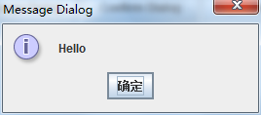
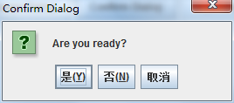
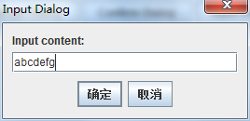

Slide 77
File Dialog
JFileChoose class will create a file dialog. First, by calling the default constructor to initiate an instance:
JFileChoose fc = new JFileChoose();
Then call the showSaveDialog() method to open a “Save as…” dialog or showOpenDialog() method to open an “Open file” dialog.
public int showSaveDialog(Component parent);
public int showOpenDialog(Component parent);
Here, parent is the container that holds the dialog. If the return value is 0, then the file will be operated.

Slide 78
public class FileDialogDemo implements ActionListener {
JFrame frame;
JButton btn;
JTextField text;
JTextArea area;
FileDialogDemo(){
frame = new JFrame("File Dialog Demo");
frame.setBounds(100,100,400,400);
frame.setDefaultCloseOperation(JFrame.EXIT_ON_CLOSE);
frame.setLayout(new FlowLayout());
btn = new JButton("Open...");
btn.addActionListener(this);
text = new JTextField(20);
text.setEditable(false);
area = new JTextArea(10,30);
area.setEditable(false);
JScrollPane scroll = new JScrollPane(area);
frame.add(btn);
frame.add(text);
frame.add(scroll);
frame.setVisible(true);
}

Slide 79
@Override
public void actionPerformed(ActionEvent arg0) {
// TODO Auto-generated method stub
if(arg0.getSource() == btn) {
JFileChooser fc = new JFileChooser();
int state = fc.showOpenDialog(frame);
if(state == JFileChooser.APPROVE_OPTION) {
String filename = "";
File dir = fc.getCurrentDirectory();
String name = fc.getSelectedFile().getName();
filename = filename + dir.getAbsolutePath() + name;
text.setText(filename);
area.setText(null);
try {
File file = new File(dir,name);
String line;
FileReader fr = new FileReader(file);
BufferedReader br = new BufferedReader(fr);
while((line = br.readLine()) != null) {
area.append(line + "\n");
}
br.close();
fr.close();
}catch(Exception e) {}
}
}
}

Slide 80
Menu
Menu bar
JMenuBar class is used to create a menu bar, then a container call the setJMenuBar() method to append.
Menu
A JMenu object is for a menu.
Menu Item
As JMenu is the subclass of JMenuItem, both of them can be added to a menu via add method.
Icon
Icon icon = new ImageIcon(“a.gif”);

Slide 81
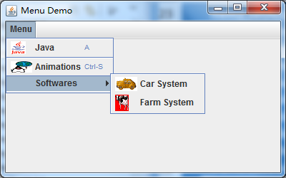
MenuDemo(){
JFrame frame = new JFrame("Menu Demo");
frame.setBounds(100,100,400,250);
frame.setDefaultCloseOperation(JFrame.EXIT_ON_CLOSE);
JMenuBar menubar = new JMenuBar();
JMenu menu = new JMenu("Menu");
JMenu subMenu = new JMenu("Softwares");
JMenuItem item1 = new JMenuItem("Java",new ImageIcon("a.gif"));
JMenuItem item2 = new JMenuItem("Animations",new ImageIcon("b.gif"));
item1.setAccelerator(KeyStroke.getKeyStroke('A'));
item2.setAccelerator(KeyStroke.getKeyStroke(KeyEvent.VK_S,InputEvent.CTRL_MASK));
menu.add(item1);
menu.addSeparator();
menu.add(item2);
menu.add(subMenu);
subMenu.add(new JMenuItem("Car System",new ImageIcon("c.gif")));
subMenu.add(new JMenuItem("Farm System",new ImageIcon("d.gif")));
menubar.add(menu);
frame.setJMenuBar(menubar);
frame.setVisible(true);
}

